Slide 1
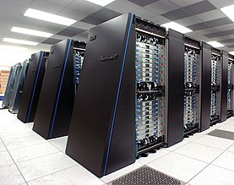
WHAT IS SUPER COMPUTER
A supercomputer is a computer that performs at or near the highest operational rate for computers. Traditionally, supercomputers have been used for scientific and engineering applications that must handle massive databases, do a great amount of computation or both.

Slide 2
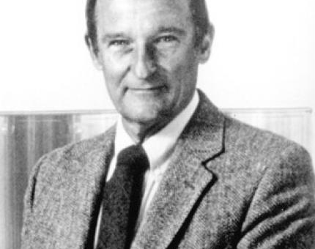
WHEN WAS INTODUCE SUPER COMPUTER AND WHO INVENT
Seymour Cray unveiled the CRAY-1 in 1976, considered the first supercomputer. Born in Chippewa Falls, Wisconsin, Cray was interested in chemistry and radio as a child. After a brief service during World War II, he went to the University of Minnesota where he studied engineering.

Slide 3
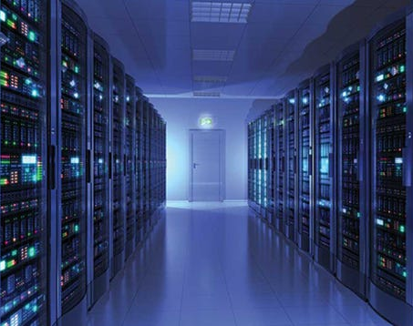
SUPER COMPUTER BASED TECQLOGY
Supercomputing technology comprises supercomputers, the fastest computers in the world. Supercomputers are made up of interconnects, I/O systems, memory and processor cores. Unlike traditional computers, supercomputers use more than one central processing unit (CPU).

